Slide 1
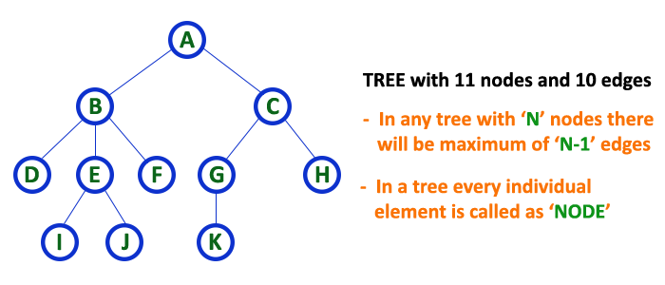
Introduction
A tree structure means that the data are organized so that items of information are related by branches
Examples:

Slide 2
Introduction
Definition (recursively): A tree is a finite set of one or more nodes such that
  There is a specially designated node called root.
  The remaining nodes are partitioned into n>=0 disjoint set T₁,…,T_{n}, where each of these sets is a tree. T₁,…,T_{n} are called the subtrees of the root.
Every node in the tree is the root of some subtree

Slide 3
Introduction
Some Terminology
  node: the item of information plus the branches to each node.
  degree: the number of subtrees of a node
  degree of a tree: the maximum of the degree of the nodes in the tree.
  terminal nodes (or leaf): nodes that have degree zero
  nonterminal nodes: nodes that don’t belong to terminal nodes.
  children: the roots of the subtrees of a node X are the children of X
  parent: X is the parent of its children.

Slide 4
Introduction
Some Terminology (cont’d)
  siblings: children of the same parent are said to be siblings.
  Ancestors of a node: all the nodes along the path from the root to that node.
  The level of a node: defined by letting the root be at level one. If a node is at level l, then it children are at level l+1.
  Height (or depth): the maximum level of any node in the tree

Slide 5
Introduction
Example
  A is the root node
  B is the parent of D and E
  C is the sibling of B
  D and E are the children of B
  D, E, F, G, I are external nodes, or leaves
  A, B, C, H are internal nodes
  The level of E is 3
  The height (depth) of the tree is 4
  The degree of node B is 2
  The degree of the tree is 3
  The ancestors of node I is A, C, H
  The descendants of node C is F, G, H, I
Property: (# edges) = (#nodes) - 1
Level
A
1
B
C
2
H
3
D
E
F
G
I
4

Slide 6
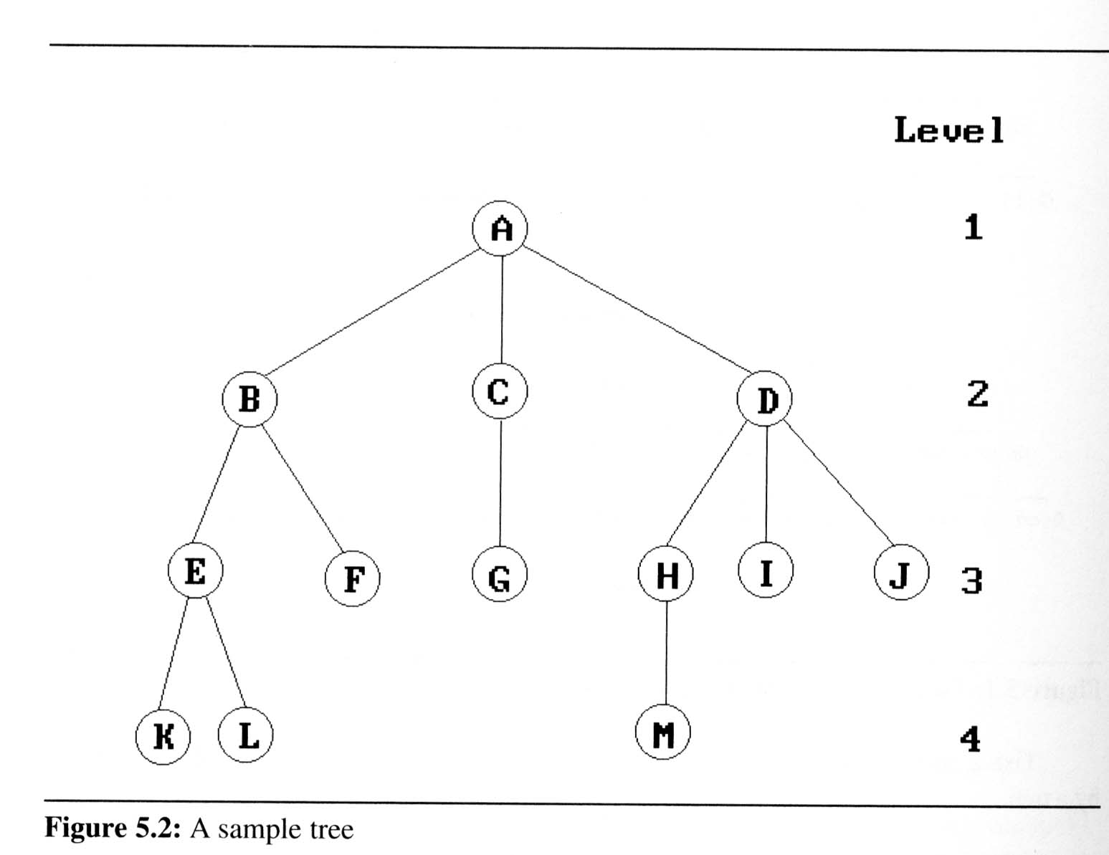

Introduction
Representation Of Trees
  List Representation
    we can write of Figure 5.2 as a list in which each of the subtrees is also a list
  ( A ( B ( E ( K, L ), F ), C ( G ), D ( H ( M ), I, J ) ) )
    The root comes first,
    followed by a list of sub-trees

Slide 7

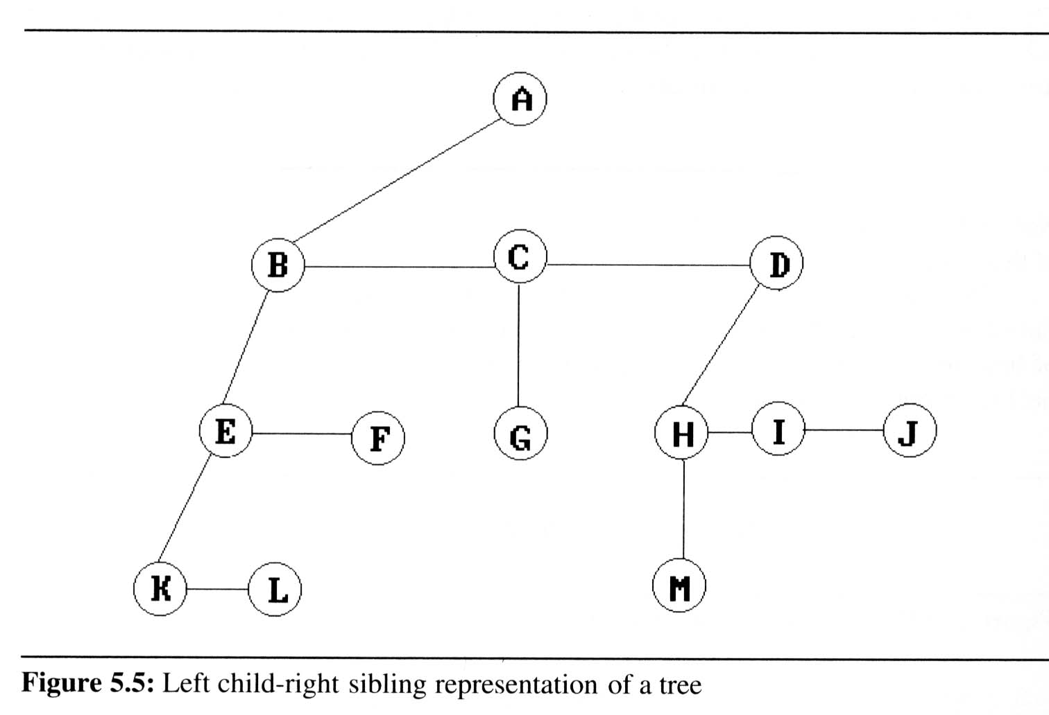
Introduction
Representation Of
Trees (cont’d)
  Left Child-
  Right Sibling
  Representation

Slide 8
Binary Trees
Binary trees are characterized by the fact that any node can have at most two branches
Definition (recursive):
  A binary tree is a finite set of nodes that is either empty or consists of a root and two disjoint binary trees called the left subtree and the right subtree
Thus the left subtree and the right subtree are distinguished
Any tree can be transformed into binary tree
  by left child-right sibling representation
A
A
B
B

Slide 9
Binary tree types

Slide 10
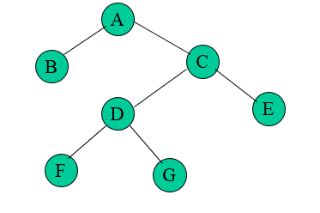
Strictly Binary tree
If every nonleaf node in a binary tree has nonempty left and right subtrees, the tree is called a strictly binary tree.(all non leaf node have degree either two or zero not one)
A strictly binary tree with n leaves always contains 2n -1 nodes.

Slide 11
Complete Binary tree
A complete binary tree is a binary tree whose all levels except the last level are completely filled and all the leaves in the last level are all to the left side and is strict binary tree.

Slide 12
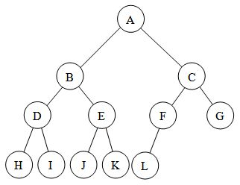
Almost Complete Binary tree
An almost complete binary tree is a binary tree whose all levels except the last level are completely filled and all the leaves in the last level are all to the left side and need not be strict binary tree.
Every complete BT is also almost complete but every almost complete binary tree need not be complete.

Slide 13
Binary Trees
Binary tree representations (using array)
  Lemma 5.3: If a complete binary tree with n nodes is represented sequentially, then for any node with index i, 1 ≤ i ≤ n, we have
  parent(i) is at ⎣i /2⎦ if i ≠ 1.
  If i = 1, i is at the root and has no parent.
  LeftChild(i) is at 2i if 2i ≤ n.
  If 2i > n, then i has no left child.
  RightChild(i) is at 2i+1 if 2i+1 ≤ n.
  If 2i +1 > n, then i has no right child
A
1
[1]
[2]
[3]
[4]
[5]
[6]
[7]
B
2
C
3
A B C — D — E
Level 1
D
E
Level 2
Level 3
4
5
6
7

Slide 14
Samples of Trees
Skewed Binary Tree
Complete Binary Tree
1
A
A
2
B
B
C
3
C
D
E
F
G
4
D
H
I
5
E
CHAPTER 5

Slide 15
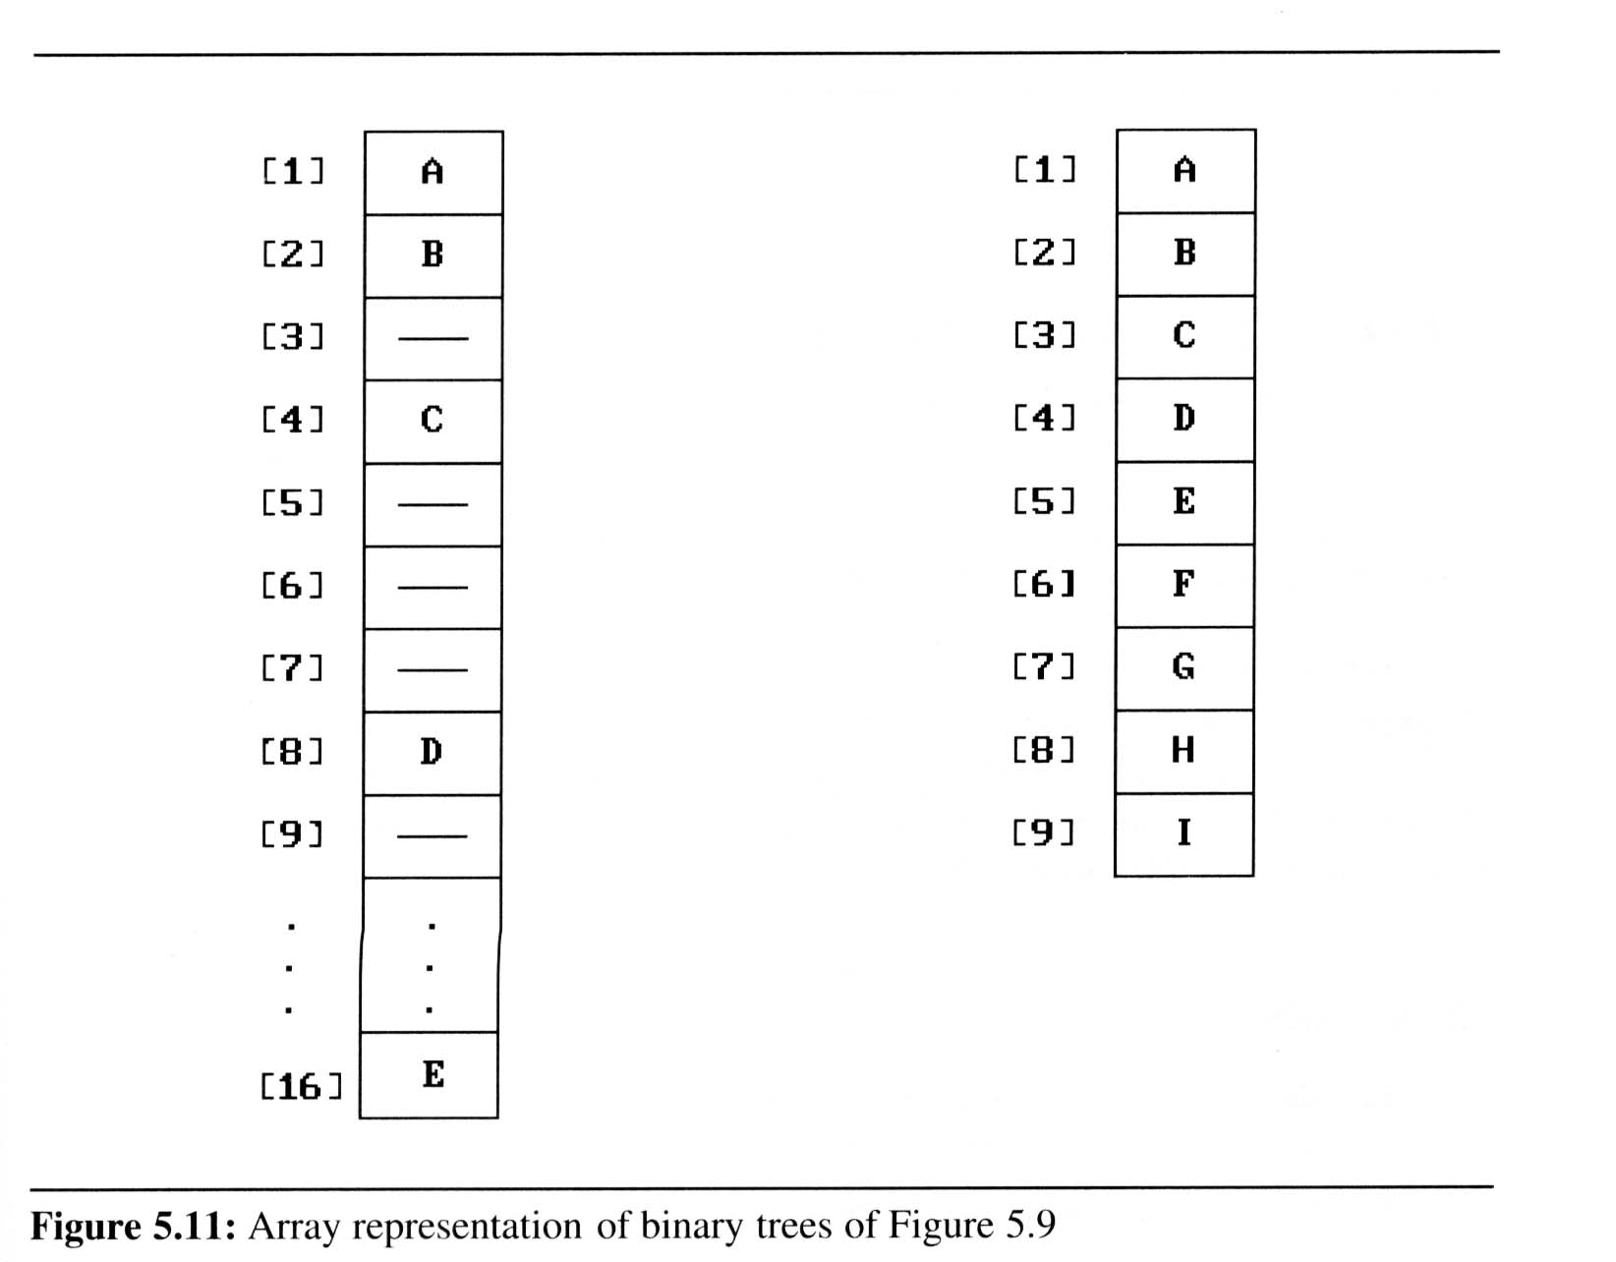
Binary Trees
Binary tree representations (using array)
  Waste spaces: in the worst case, a skewed tree of depth k requires 2^{k}-1 spaces. Of these, only k spaces will be occupied
  Insertion or deletion
  of nodes from the
  middle of a tree
  requires the
  movement of
  potentially many nodes
  to reflect the change in
  the level of these nodes

Slide 16
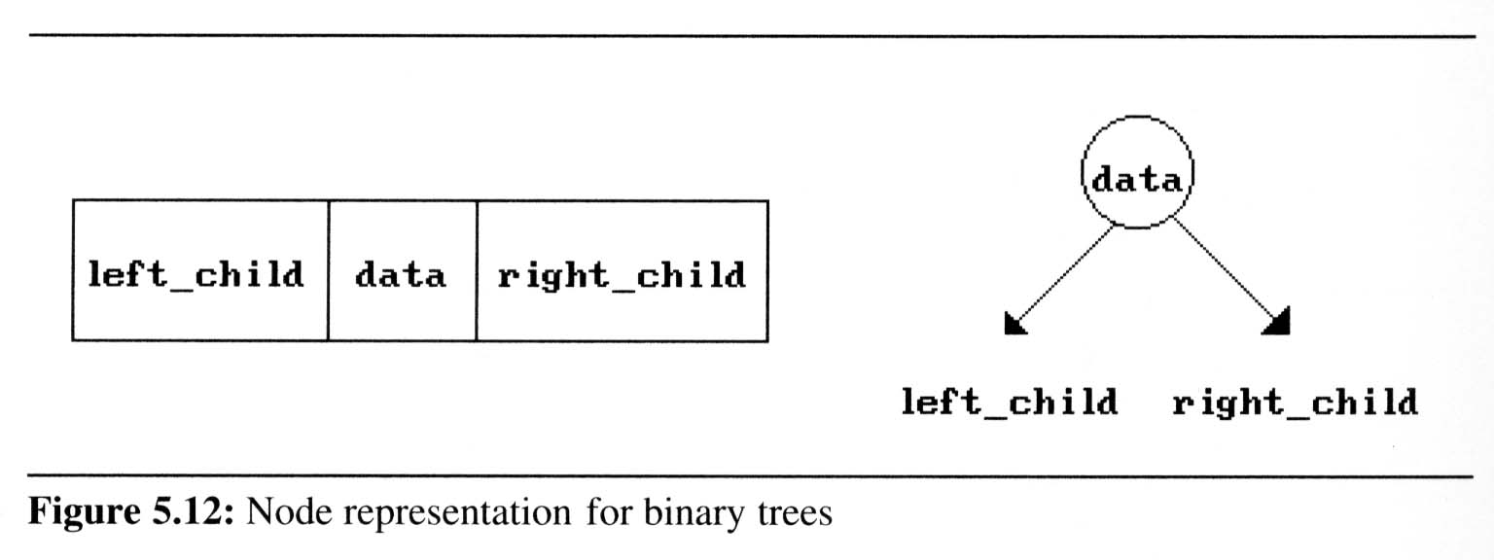
Binary Trees
Binary tree representations (using link)
class tree_node
{
int data;
tree_node *lc,*rc;};

Slide 17
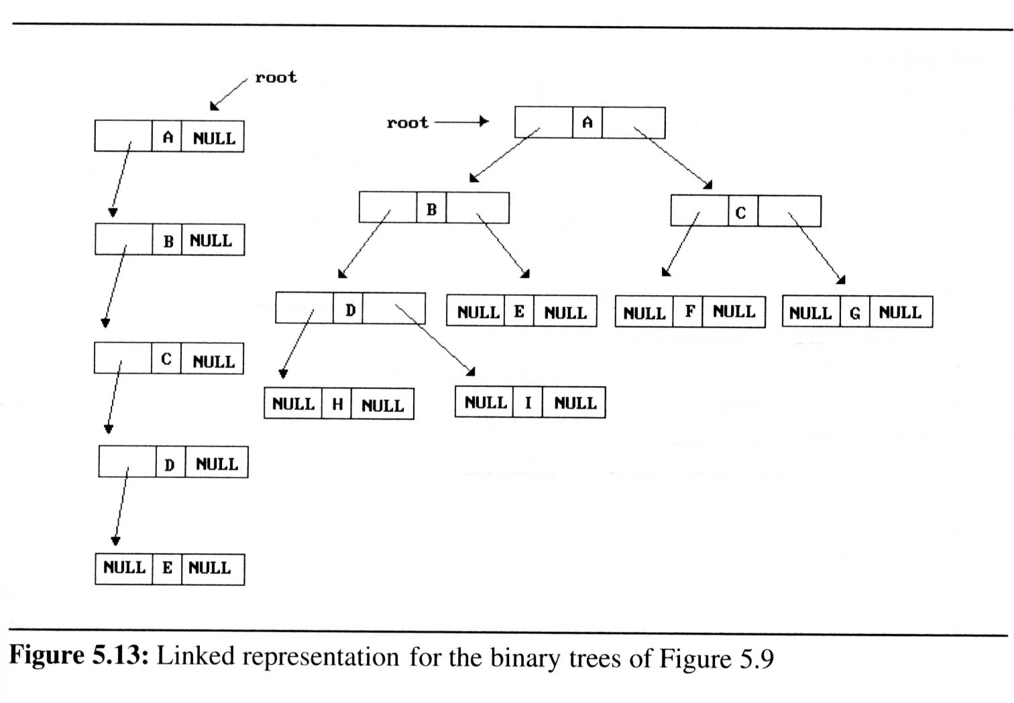
Binary Trees
Binary tree representations (using link)

Slide 18
Binary tree Properties

Slide 19
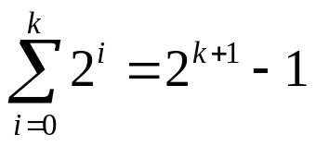
Maximum Number of Nodes in a Binary Tree
The maximum number of nodes on depth i of a binary tree is 2^{i}, i>=0.
The maximum nubmer of nodes in a binary tree of height k is 2^{k+1}-1, k>=0.
Prove by induction.

Slide 20
Full BT VS Complete BT
A full binary tree of depth k is a binary tree of
depth k having 2 -1 nodes, k>=0.
A binary tree with n nodes and depth k is
complete iff its nodes correspond to the nodes numbered from 1 to n in the full binary tree of
depth k.
k
1
1
2
3
2
3
4
5
6
7
4
5
6
7
8
9
8
9
10
11
12
13
14
15
Complete binary tree
CHAPTER 5
Full binary tree of depth 4

Slide 21
Relations between Number of
Leaf Nodes and Nodes of Degree 2
For any nonempty binary tree, T, if n₀ is the
number of leaf nodes and n₂ the number of nodes
of degree 2, then n₀=n₂+1
proof:
Let n and B denote the total number of nodes &
branches in T.
Let n₀, n₁, n₂ represent the nodes with no children,
single child, and two children respectively.
n= n₀+n₁+n₂, B+1=n, B=n₁+2n₂ ==> n₁+2n₂+1= n,
n₁+2n₂+1= n₀+n₁+n₂ ==> n₀=n₂+1
CHAPTER 5

Slide 22
Binary Tree Traversals
How to traverse a tree or visit each node in the tree exactly once?
  There are six possible combinations of traversal
LVR, LRV, VLR, VRL, RVL, RLV
  Adopt convention that we traverse left before
  right, only 3 traversals remain
LVR (inorder), LRV (postorder), VLR (preorder)
left_child
data
right_child
V
:
visiting
node
L: moving left
R: moving right

Slide 23
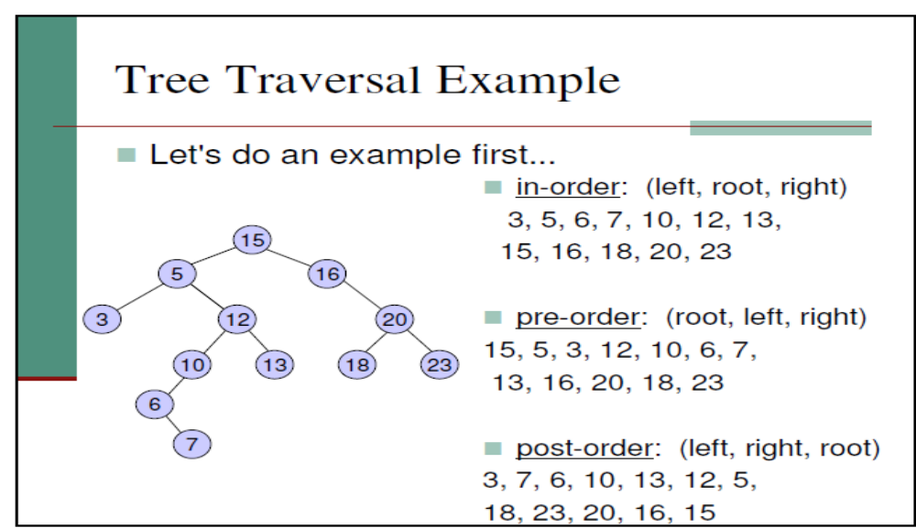

Slide 24
Arithmetic Expression Using BT
+
inorder traversal
A / B * C * D + E
infix expression
preorder traversal
+ * * / A B C D E
prefix expression
postorder traversal
A B / C * D * E +
postfix expression
level order traversal
+ * E * D / C A B
*
E
*
D
/
C
A
B
CHAPTER 5

Slide 25
inorder: EFBGCHIJDA
preorder: ABEFCGDHIJ
A
B
C
D
E
F
H
J
G
I
preorder
B
E
F
C
G
D
H
I
J
CHAPTER 5

Slide 26
tree_node *createBT()
{
tree_node *p;
int x;
cout<<"Enter data(-1 for no data):";
cin>>x;
if(x==-1)
return NULL;
p=new tree_node;
p->data=x;
cout<<"Enter left child of “<<x<<“:”;
p->lc=createBT();
cout<<"Enter right child of “<<x<<“:”;
p->rc=createBT();
return p;
}
Binary tree creation using recursive method.
class tree_node
{
int data;
tree_node *lc,*rc;};
Enter data(-1 for no data):5
Enter left child of 5:
Enter data(-1 for no data):7
Enter left child of 7:
Enter data(-1 for no data):8
Enter left child of 8:
Enter data(-1 for no data):3
Enter left child of 3:
Enter data(-1 for no data):-1
Enter right child of 3:
Enter data(-1 for no data):-1
Enter right child of 8:
Enter data(-1 for no data):-1
Enter right child of 7:
Enter data(-1 for no data):-1
Enter right child of 5:
Enter data(-1 for no data):-1
Calling create function in main
tree_node *root;
root=createBT();

Slide 27
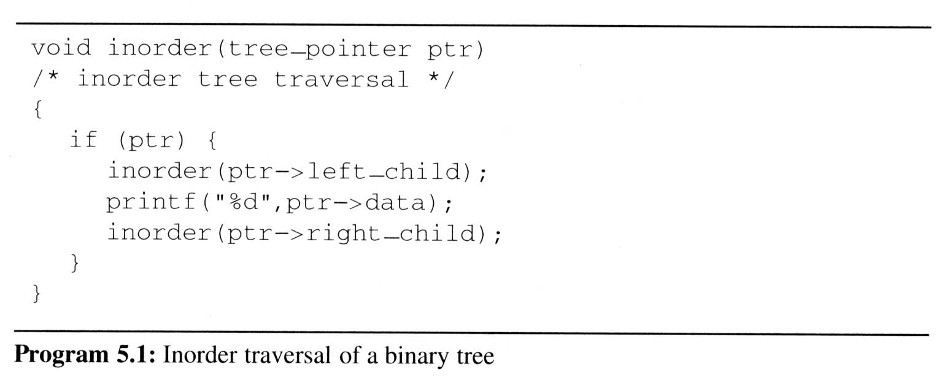
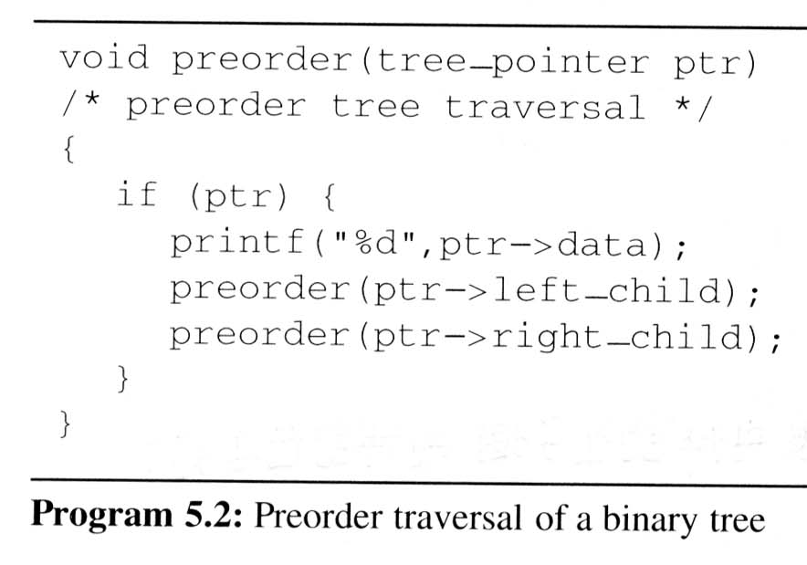
Traversal code (replace printf by cout,left_child by lc and right_child by rc tree_pointer by tree_node*)

Slide 28
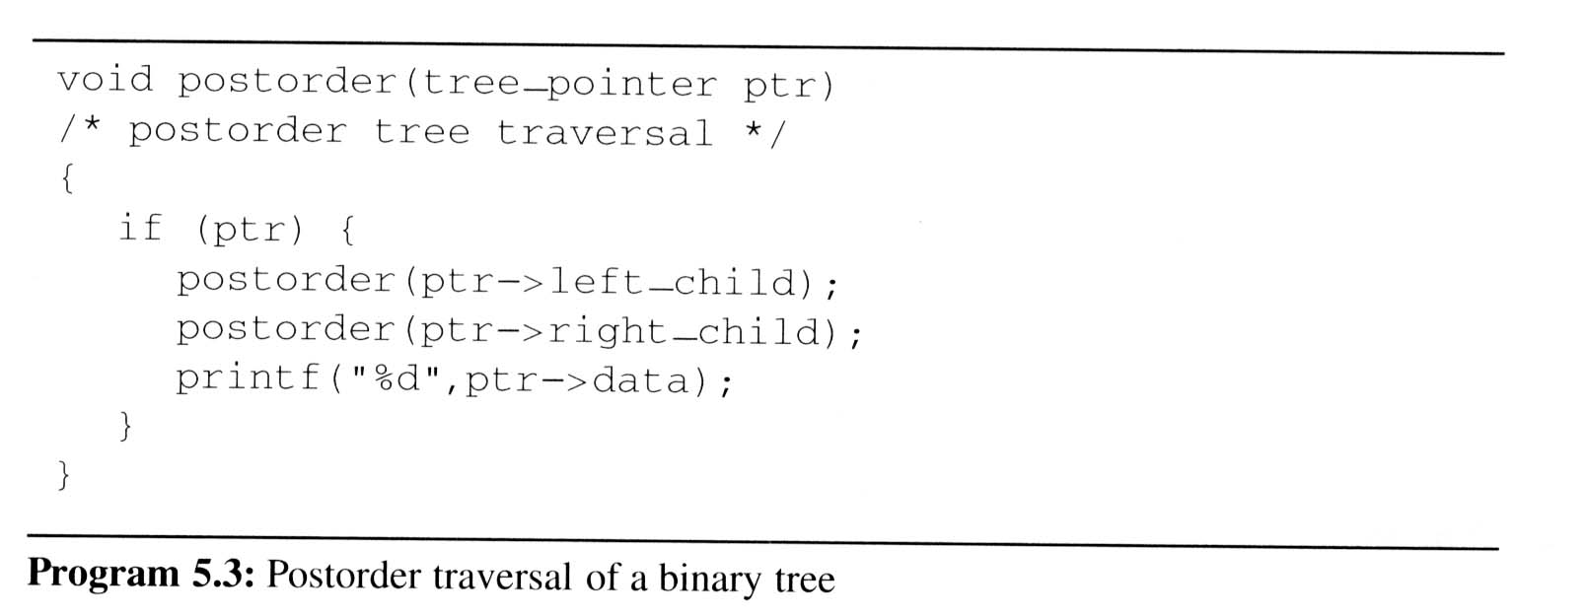
(replace printf by cout,left_child by lc, right_child by rc and tree-pointer by tree_node*)

Slide 29
void treenode::preorder(treenode* ptr)
{
int top=-1;
treenode *stack[10];
do{
for(;ptr;ptr=ptr->leftchild)
{
cout<<ptr->data<<" ";
stack[++top]=ptr;
}
if(top>=0) ptr=stack[top--];
else break;
ptr=ptr->rightchild;
}while(1);
}

Slide 30
void treenode::inorder(treenode* ptr)
{
int top=-1;
treenode *stack[10];
do{
for(;ptr;ptr=ptr->leftchild)
stack[++top]=ptr;
if(top>=0) ptr=stack[top--];
else break;
cout<<ptr->data;
ptr=ptr->rightchild;
}while(1);
}

Slide 31
Iterative Postorder traversal
1.1 Create an empty stack
2.1 Do following while root is not NULL
a) Push root's right child and then root to stack.
b) Set root as root's left child.
2.2 Pop an item from stack and set it as root.
a) If the popped item has a right child and the right child
is at top of stack, then remove the right child from stack,
push the root back and set root as root's right child.
b) Else print root's data and set root as NULL.
2.3 Repeat steps 2.1 and 2.2 while stack is not empty.

Slide 32
void postOrderIterative(tree_node* root)
{
if (root == NULL)
return;
Stack stack;
do
{
while (root)
{
// Push root's right child and then root to stack.
if (root->rc) push(root->rc);
push( root);
// Set root as root's left child
root = root->lc;
}

Slide 33
root = stack.pop();
// If the popped item has a right child and the right child is not
// processed yet, then make sure right child is processed before root
if (root->rc && peek() == root->rc)
{
stack.pop(); // remove right child from stack
stack.push(root); // push root back to stack
root = root->rc; // change root so that the right
// child is processed next
}

Slide 34
else // Else print root's data and set root as NULL
{
cout<<root->data);
root = NULL;
}
} while (!isEmpty());
}

Slide 35
void treenode::level_order(treenode* ptr)
{ int front=-1;
int rear=-1;
treenode *Q[10];
if(!ptr) return;
Q[++rear]=ptr;
do
{ ptr=Q[++front];
cout<<ptr->data<<" ";
if(ptr->leftchild) Q[++rear]=ptr->leftchild;
if(ptr->rightchild) Q[++rear]=ptr->rightchild;
}while(front!=rear);
}

Slide 36
Copying a BT
treenode *treenode::copy(treenode *ptr)
{
treenode *temp;
if(ptr)
{
temp=new treenode;
if(ptr->leftchild) temp->leftchild=copy(ptr->leftchild);
if(ptr->rightchild) temp->rightchild=copy(ptr->rightchild);
temp->data=ptr->data;
return(temp);
}
return(NULL);
}

Slide 37
int treenode::depth(treenode *ptr)
{
int ldepth,rdepth;
if(ptr==NULL) return 0;
else
{ ldepth=depth(ptr->leftchild);
rdepth=depth(ptr->rightchild);
if(ldepth>rdepth) return ldepth+1;
else return rdepth+1;
}
}

Slide 38
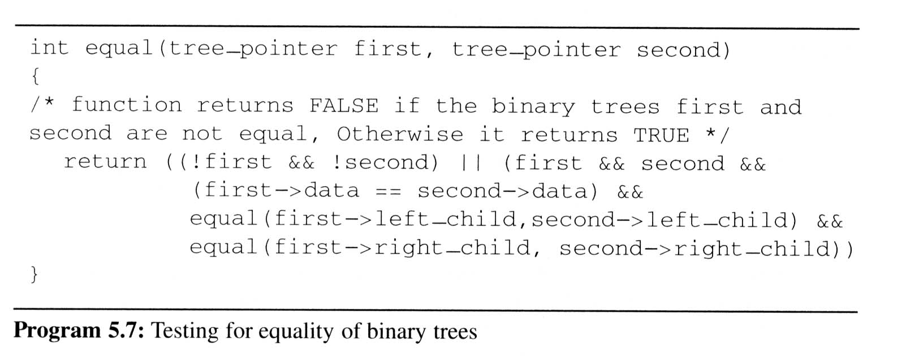
Checking if Two BT’s are containing same data

Slide 39
treenode* treenode::parent(treenode *curr,int ele, treenode *prev)
{
if(curr!=NULL)
{
parent(curr->leftchild, ele, curr);
if(ele==curr->data)
{
cout<<"\n parent : "<<prev->data;
return prev;
}
parent(curr->rightchild, ele , curr);
}
}

Slide 40
void treenode::ancestors(int ele)
{
treenode *p;
p=parent(root, ele, root);
while(1)
{
p=parent(root, p->data, root);
if(p==root) break;
}
}

Slide 41
Binary Search Trees
Definition of binary search tree:
  Every element has a unique key
  The keys in a nonempty left subtree (right subtree) are smaller (larger) than the key in the root of subtree
  The left and right subtrees are also binary search trees

Slide 42
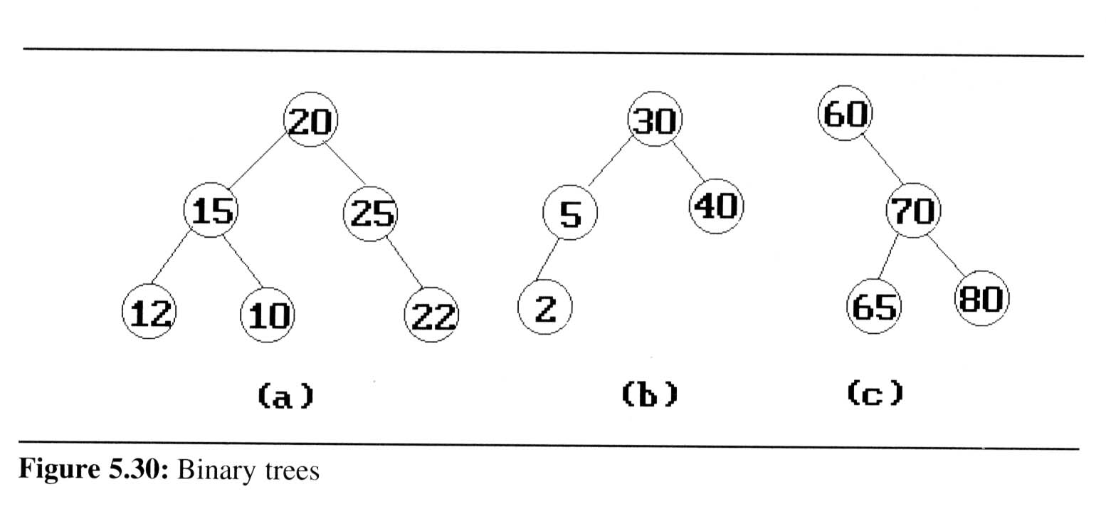
Binary Search Trees
Example: (b) and (c) are binary search trees
medium
smaller
larger

Slide 43
Binary Search Trees
Search:
Search(25)
Search(76)
44
17
88
32
65
97
28
54
82
29
76
80

Slide 44
binary search tree class
class bst
{
bst *lchild;
int data;
bst *rchild;
public:
bst(int ele=0)
{
lchild=NULL;
rchild=NULL;
data=ele;
}
void insert(int);
void search(int);
void display(bst *root);
void del(int);
};
bst *root=NULL;

Slide 45
Insert into binary search tree
void bst::insert(int ele)
{ bst *temp=new bst(ele);
if(root==NULL){root=temp;return;}
else
{ bst *curr=root,*prev=NULL;
while(curr)
{
prev=curr;
if(temp->data<curr->data) curr=curr->lchild;
else if(temp->data>curr->data) curr=curr->rchild;
else
{ cout<<"Insertion is not possible";
return;
}
}
if(temp->data>prev->data)
prev->rchild=temp;
else if(temp->data<prev->data)
prev->lchild=temp;
}
return;
}

Slide 46
binary search tree: Display
void bst::display(bst *ptr)
{
if(ptr){
display(ptr->lchild);
cout<<" "<<ptr->data;
display(ptr->rchild);
}
}

Slide 47
Binary Search Trees
Deletion from a binary search tree
  Three cases should be considered
  case 1. leaf → delete
  case 2.
  one child → delete and change the pointer to this child
  case 3. two child → either the smallest element in the right subtree or the largest element in the left subtree

Slide 48
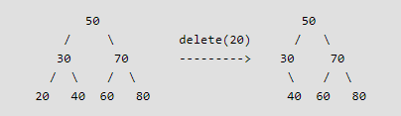
1) Node to be deleted is leaf: Simply remove from the tree.

Slide 49
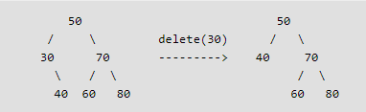
2) Node to be deleted has only one child: Copy the child to the node and delete the child

Slide 50
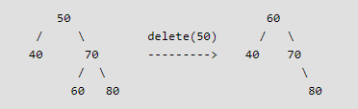
3)Node to be deleted has two children: Find inorder successor of the node. Copy contents of the inorder successor to the node and delete the inorder successor. Note that inorder predecessor can also be used.

Slide 51
/* Given a binary search tree and a key, this function deletes the key and returns the new root */
Node* deleteNode(Node* root, int k)
{ if (root == NULL) return root;
// Recursive calls for ancestors of node to be deleted
if (root->key > k) {
root->left = deleteNode(root->left, k);
return root;
}
else if (root->key < k) {
root->right = deleteNode(root->right, k);
return root;
}
// We reach here when root is the node to be deleted.
// If one of the children is empty
if (root->left == NULL) {
Node* temp = root->right;
delete root;
return temp;
}
else if (root->right == NULL) {
Node* temp = root->left;
delete root;
return temp;
}

Slide 52
// If both children exist
else {
Node* succParent = root->right;
// Find successor (smallest in the right subtree
Node *succ = root->right;
while (succ->left != NULL) {
succParent = succ;
succ = succ->left;
}
// Delete successor. Since successor is always left child of its parent we can safely make successor's right right child as left of its parent.
succParent->left = succ->right;
// Copy Successor Data to root
root->key = succ->key;
// Delete Successor and return root
delete succ;
return root;
}
}

Slide 53
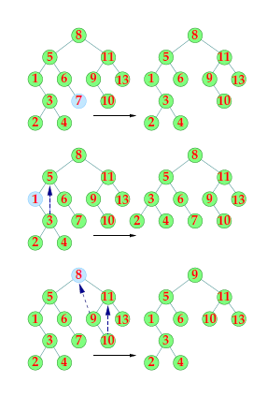

Slide 54
// Helper function to find minimum value node in subtree rooted at curr
Node* minimumKey(Node* curr)
{
while(curr->left != nullptr) {
curr = curr->left;
}
return curr;
}
// Iterative function to search in subtree rooted at curr & set its parent
// Note that curr & parent are passed by reference
void searchKey(Node* &curr, int key, Node* &parent)
{ // traverse the tree and search for the key
while (curr != nullptr && curr->data != key)
{ parent = curr;
// if given key is less than the current node, go to left subtree
// else go to right subtree
if (key < curr->data) curr = curr->left;
else curr = curr->right;
}
}

Slide 55
void deleteNode(Node*& root, int key)
{
Node* parent = nullptr; // pointer to store parent node of current node
Node* curr = root; // start with root node
searchKey(curr, key, parent); // search key in BST and set its parent pointer
if (curr == nullptr) return; // return if key is not found in the tree
// Case 1: node to be deleted has no children i.e. it is a leaf node
if (curr->left == nullptr && curr->right == nullptr)
{ // if node to be deleted is not a root node, then set its
// parent left/right child to null
if (curr != root)
{
if (parent->left == curr) parent->left = nullptr;
else parent->right = nullptr;
}
// if tree has only root node, delete it and set root to null
else root = nullptr;
// deallocate the memory
delete(curr); // or delete curr;
}

Slide 56
// Case 2: node to be deleted has two children
else if (curr->left && curr->right)
{
// find its in-order successor node
Node* successor = minimumKey(curr->right);
// store successor value
int val = successor->data;
// recursively delete the successor. Note that the successor
// will have at-most one child (right child)
deleteNode(root, successor->data);
// Copy the value of successor to current node
curr->data = val;
}

Slide 57
// Case 3: node to be deleted has only one child
else
{
// find child node
Node* child = (curr->left)? curr->left: curr->right;
// if node to be deleted is not a root node, then set its parent
// to its child
if (curr != root)
{
if (curr == parent->left) parent->left = child;
else parent->right = child;
}
// if node to be deleted is root node, then set the root to child
else root = child;
// deallocate the memory
delete(curr);
}
}

Slide 58
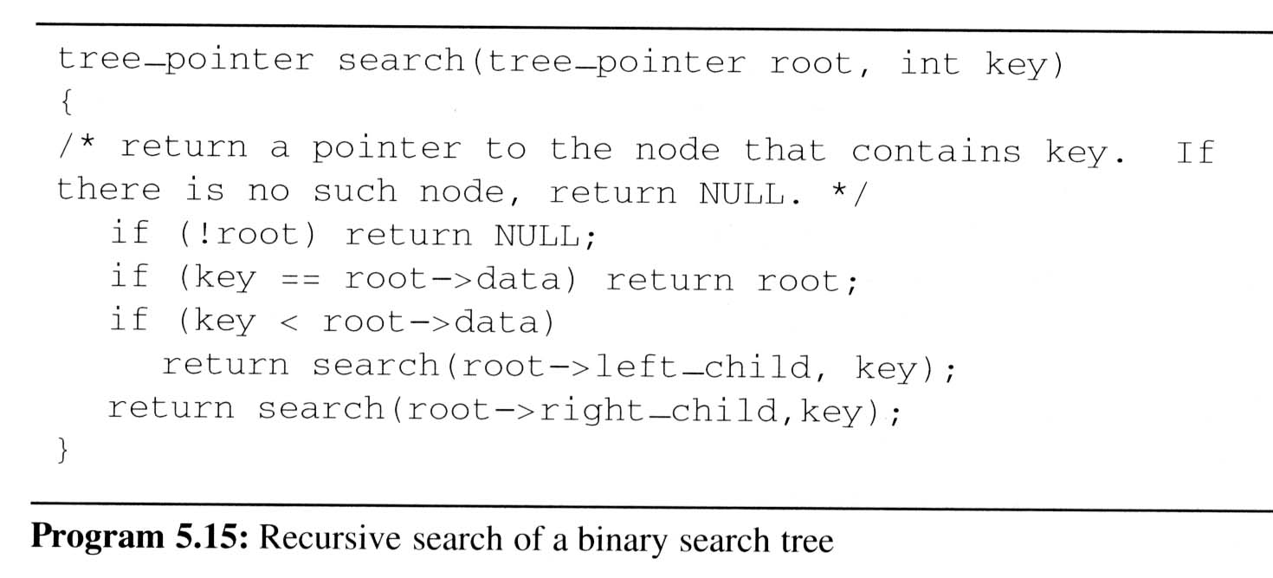
Binary Search Trees
Searching a
binary search
tree(replace tree_
_pointer by node*,
data by info,
left_child by lcl,
right_child by rcl)

Slide 59
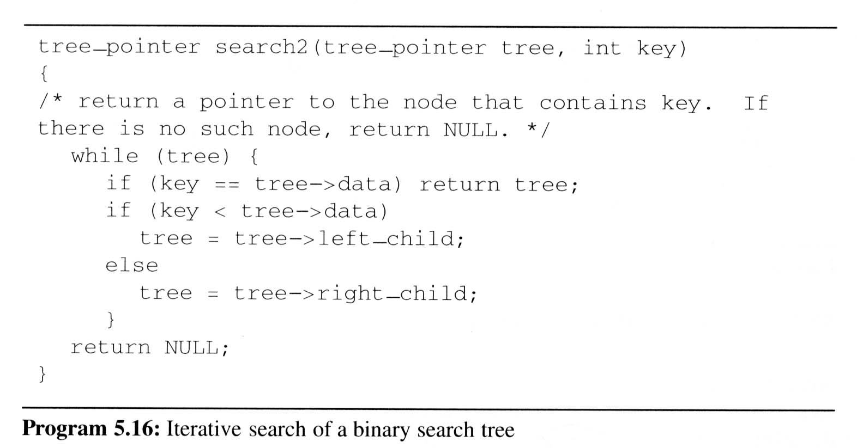


Slide 60
Binary Search Trees
Height of a binary search tree
  The height of a binary search tree with n elements can become as large as n.

Slide 61
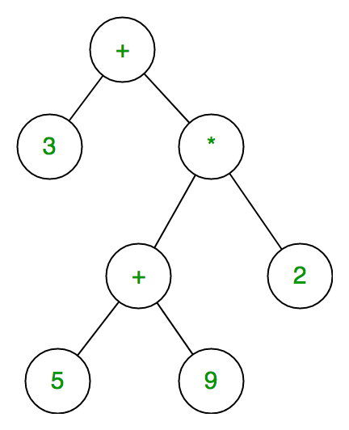
Expression tree
Expression tree is a binary tree in which each internal node corresponds to operator and each leaf node corresponds to operand so for example
expression tree for 3 + ((5+9)*2) would be:

Slide 62
Construction Of Expression tree from postfix expression
Now For constructing expression tree we use a stack. We loop through input expression and do following for every character.
1) If character is operand push that into stack
2) If character is operator pop two values from stack make them its child and push current node again.
At the end only element of stack will be root of expression tree.

Slide 63
class exp_tree
{
public:
exp_tree *left; char data; exp_tree *right;
exp_tree(){ }
exp_tree(char ele)
{
data=ele; left=NULL; right=NULL;
}
exp_tree* create(char);
void inorder(exp_tree *);
}*root=NULL;
exp_tree* exp_tree::create(char ele)
{
exp_tree *temp=new exp_tree(ele);
return temp;
}

Slide 64
int main()
{
char postfix[10];
int i=0,top=-1;
exp_tree *stack[10],obj;
cout<<"Enter the postfix expression: "; cin>>postfix;
while(i<strlen(postfix))
{
if(isalpha(postfix[i])) stack[++top]=obj.create(postfix[i]);
else
{
root=obj.create(postfix[i]);
root->right=stack[top--];
root->left=stack[top--];
stack[++top]=root;
} i++;
}obj.inorder(root);
getch();
}

Slide 65
Threaded Binary Tree
A threaded binary tree defined as follows: "A binary tree is threaded by making all right child pointers that would normally be null point to the inorder successor of the node (if it exists), and all left child pointers that would normally be null point to the inorder predecessor of the node."

Slide 66
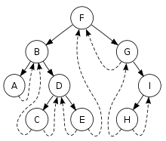
Threaded Tree Example
8/8/02

Slide 67
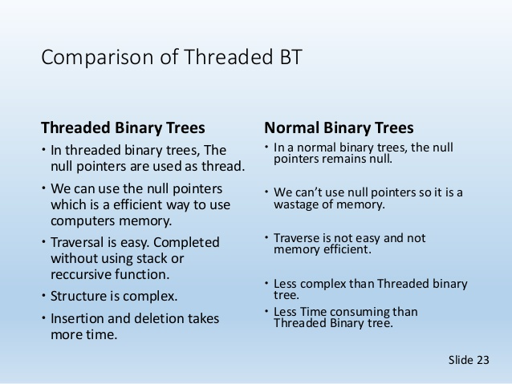

Slide 68
Heaps (1/6)
The heap abstract data type
  Definition: A max(min) tree is a tree in which the key value in each node is no smaller (larger) than the key values in its children. A max (min) heap is a almost complete binary tree that is also a max (min) tree
  Basic Operations:
    creation of an empty heap
    insertion of a new element into a heap
    deletion of the largest element from the heap

Slide 69
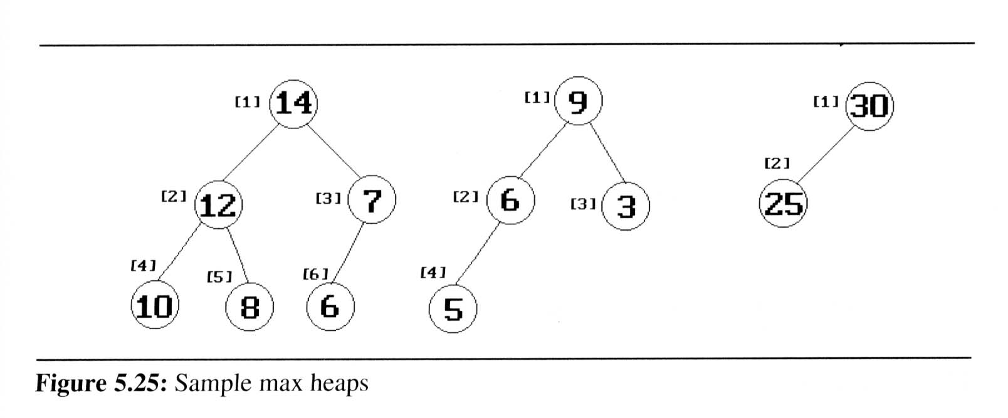
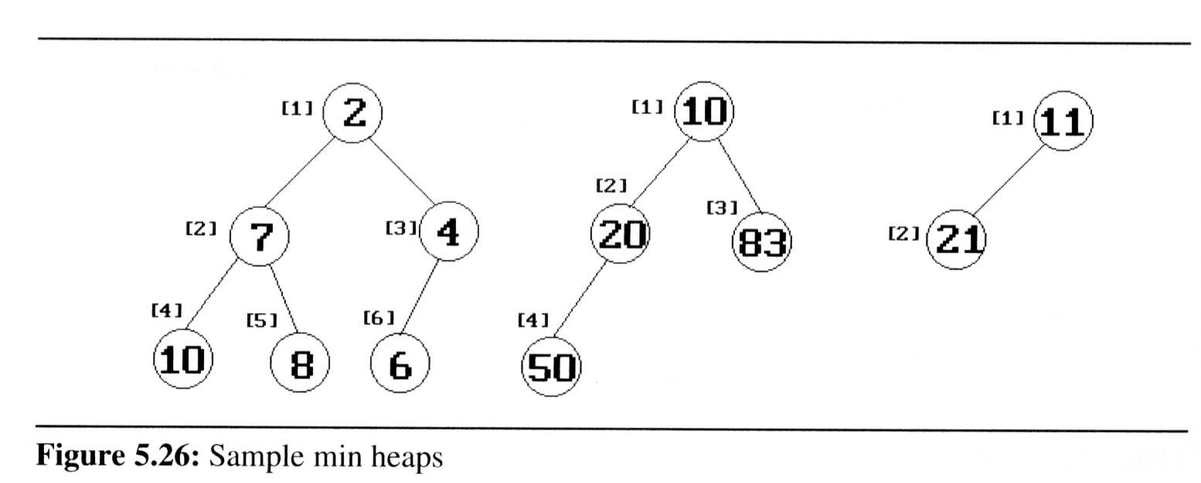
Heaps (2/6)
The examples of max heaps and min heaps
  Property: The root of max heap (min heap) contains the largest (smallest) element

Slide 70
Priority queues
  Heaps are frequently used to implement priority queues
  delete the element with highest (lowest) priority
  insert the element with arbitrary priority
  Heaps is the only way to implement priority queue

Slide 71
Operations on heaps:
  insertion of a new element into the heap
  deletion of the largest (max heap)/smallest (min heap) element from the heap
  sort
CHAPTER 5

Slide 72
*Figure 5.25: Sample max heaps (p.219)
[1]
14
[1]
9
[1]
30
[2]
12
[3]
7
[2]
6
[3]
3
[2]
25
[4]
[5]
[6]
[4]
10
8
6
5
Property:
The root of max heap (min heap) contains
the largest (smallest).

Slide 73
*Figure 5.26:Sample min heaps (p.220)
[1]
2
[1]
10
[1]
11
[2]
7
[3]
4
[2]
20
[3]
83
[2]
21
[4]
[5]
[6]
[4]
10
8
6
50

Slide 74
#include<iostream.h>
#include<conio.h>
class maxheap
{
int key;
public: void insert();
void sort();
void adjust(maxheap*,int);
void display();
void delMax();
};
maxheap h[50];
int n=0; //Number of elements in the heap

Slide 75
Example of Insertion to Max Heap
20
20
21
15
2
15
5
15
20
14
10
14
10
2
14
10
2
initial location of new node
insert 5 into heap
insert 21 into heap
CHAPTER 5

Slide 76
void maxheap::insert()
{
if(n==50)
cout<<"\nHeap Is Full";
else
{ maxheap temp;
cout<<"\nEnter the element:";
cin>>temp.key;
int i=++n;
while(i!=1&&temp.key>h[i/2].key)
{
h[i]=h[i/2];
i=i/2;
}
h[i]=temp;
}
display();
}
void maxheap::display()
{ cout<<"\nHeap Is: \n";
for(int i=1;i<=n;i++)
cout<<h[i].key<<"\t";
}

Slide 77
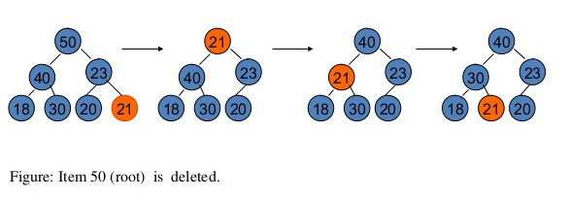

Slide 78
void maxheap::delMax()
{
int temp;
if(n==0)
{ cout<<"Heap is empty"; return; }
cout<<"Deleted item is"<<h[1].key;
h[1].key=h[n].key; n--;
int i=1;

Slide 79
while(((2*i)<=n && (2*i+1)<=n) && (h[i].key<h[2*i].key || h[i].key<h[2*i+1].key))
//complete while loop is in red colour
if(h[2*i].key>=h[2*i+1].key)
{
temp=h[i].key;
h[i].key=h[2*i].key;
h[2*i].key=temp;
i=i*2;
}
else
{
temp=h[i].key;
h[i].key=h[2*i+1].key;
h[2*i+1].key=temp;
i=2*i+1;
}
if(((2*i)<=n) && h[i].key<h[2*i].key)
{
temp=h[i].key;
h[i].key=h[2*i].key;
h[2*i].key=temp;
i=i*2;
}
}

Slide 80
void maxheap::sort()
{
int m,temp;
for(m=n;m>1;m--)
{
temp=h[1].key;
h[1].key=h[m].key;
h[m].key=temp;
adjust(h,m-1);
display();
}
}

Slide 81
void maxheap::adjust(maxheap h[],int no)
{
int i=1,temp,t;
temp=h[i].key;
while(((2*i)<=no && (2*i+1)<=no) && (h[i].key<h[2*i].key || h[i].key<h[2*i+1].key))
//complete while loop is in red colour
if(h[2*i].key>=h[2*i+1].key)
{
t=h[i].key;
h[i].key=h[2*i].key;
h[2*i].key=t;
i=i*2;
}
else
{
t=h[i].key;
h[i].key=h[2*i+1].key;
h[2*i+1].key=t;
i=2*i+1;
}
if(((2*i)<=no) && h[i].key<h[2*i].key)
{
t=h[i].key;
h[i].key=h[2*i].key;
h[2*i].key=t;
i=i*2;
}
}
}

